Slide 1
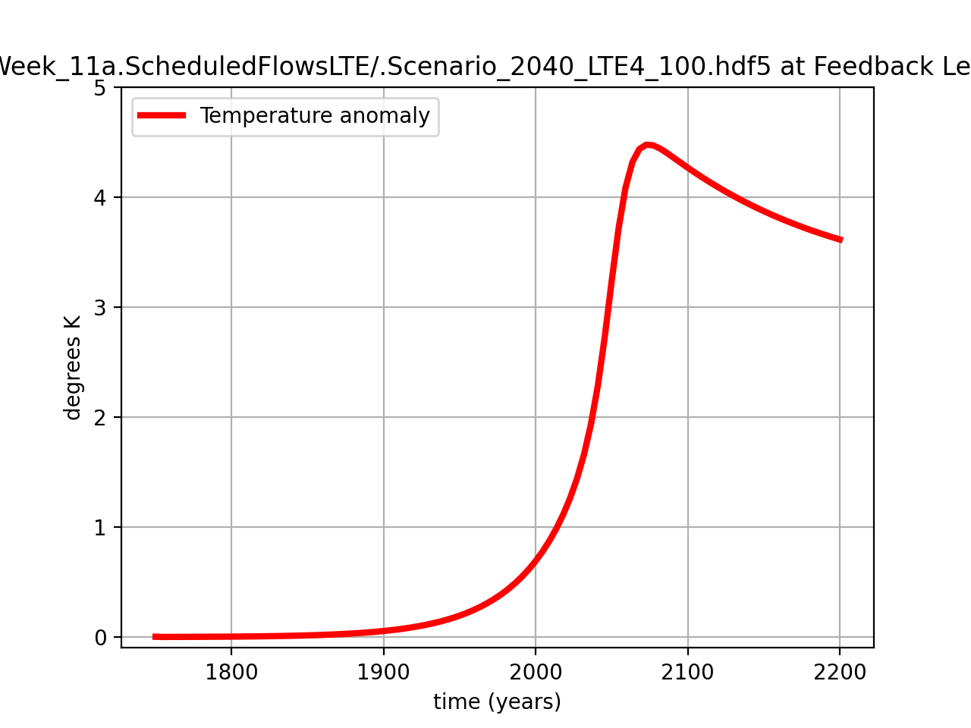

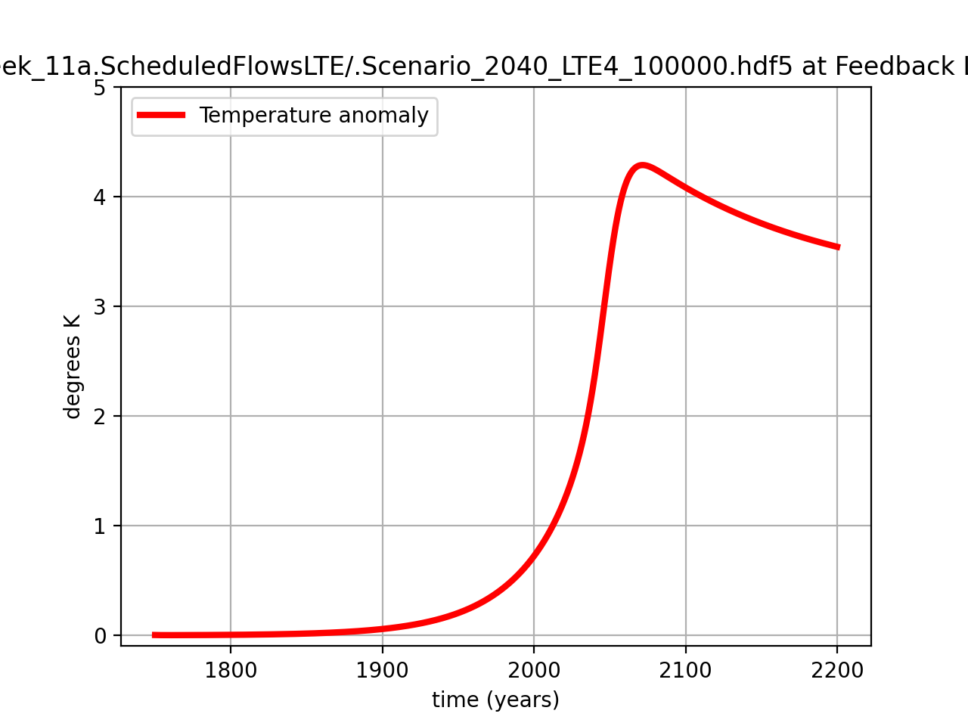

Tmax = +4.48
Tmax = +4.31
100 points
1000 points
Tmax = +4.29
Tmax = +4.29
100000 points
10000 points

